Slide 1
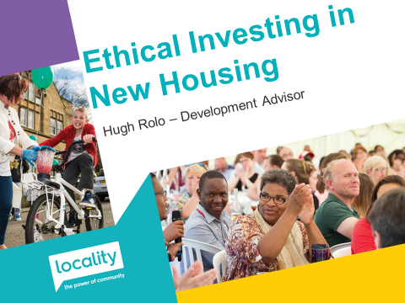

Slide 2
Long History of ethical investment

Slide 3
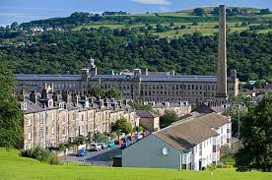

Slide 4
The Financial Crash

Slide 5
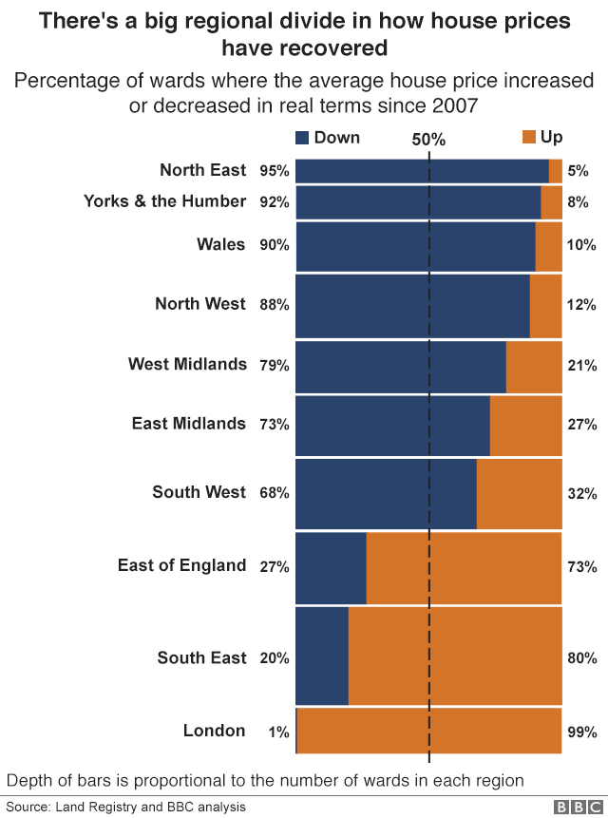

Slide 6
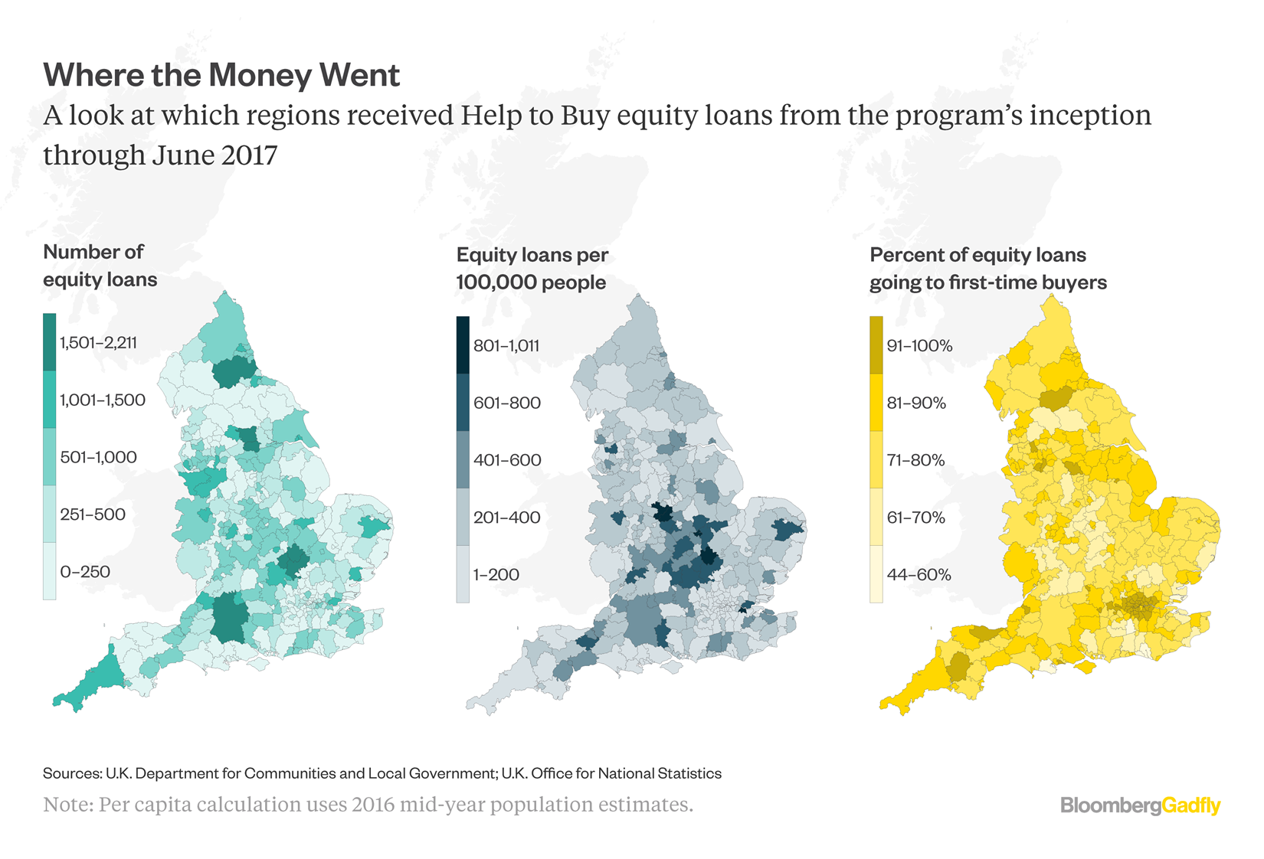

Slide 7
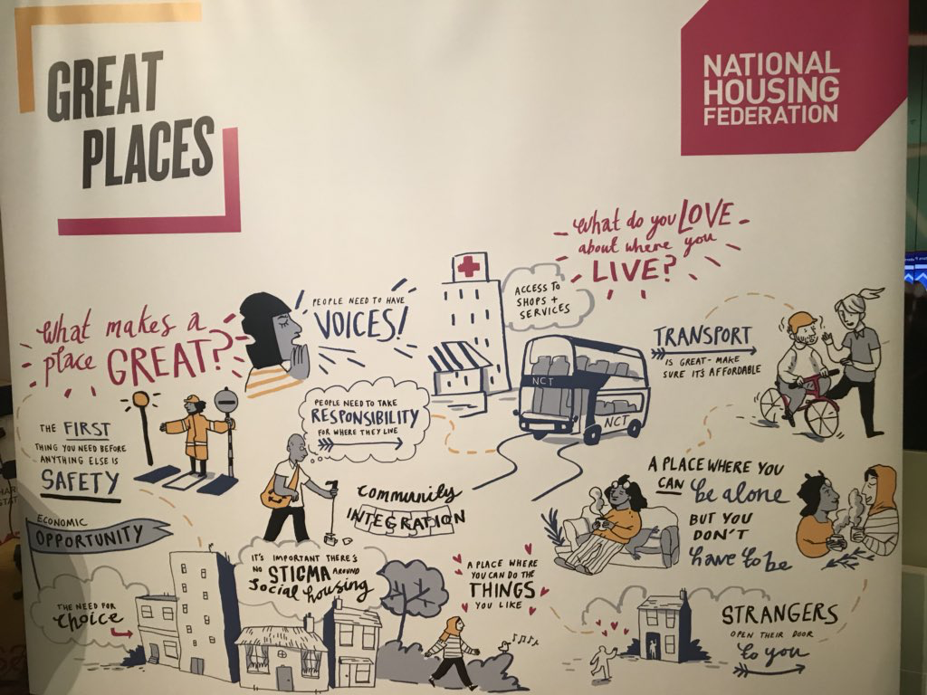
Enough gloom and doom, what can we do?

Slide 9
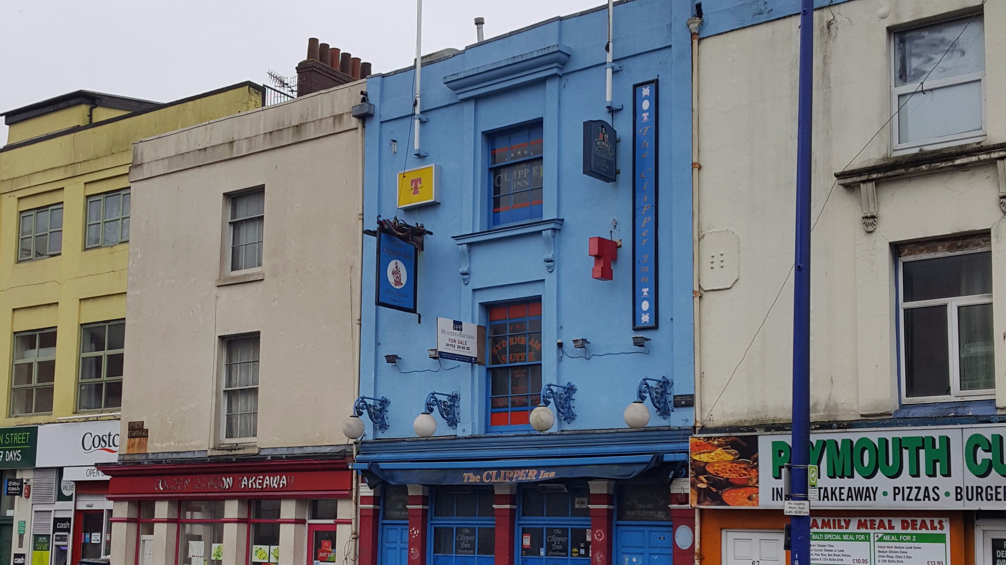

Slide 10
Climate Innovation District Leeds Community Homes

Slide 11
Yorspace
No bank of mum and dad
Cooperative principles

Slide 12
BRINGING AFFORDABLE HOMES BACK TO HEBDEN BRIDGE

